Slide 1
How IBM Watson Overpromised and Underdelivered on AI Health Care
Fabio Savorgnan, MD

Slide 2

Facts
IBM’s bold attempt to revolutionize health care began in 2011. The day after Watson thoroughly defeated two human champions in the game of Jeopardy!
IBM announced a new career path for its AI quiz-show winner: It would become an AI doctor.

Slide 3
Facts
In fact, the projects that IBM announced that first day did not yield commercial products.
The products that have emerged from IBM’s Watson Health division are nothing like the brilliant AI doctor that was once envisioned: They’re more like AI assistants that can perform certain routine tasks.

Slide 4
Facts
Trough Machine Learning,IBM researchers trained Watson by giving it thousands of Jeopardy! clues and responses that were labeled as correct or incorrect.
In this complex data set, the AI discovered patterns and made a model for how to get from an input (a clue) to an output (a correct response).

Slide 5
Facts
While some of that data can be easily digested by machines, such as lab results and vital-sign measurements, the bulk of it is “unstructured” information, such as doctor’s notes and hospital discharge summaries.
That narrative text accounts for about 80 percent of a typical patient’s record—and it’s a stew of jargon, shorthand, and subjective statements.

Slide 6
AI’s First Foray Into Health Care
Doctors are a conservative bunch—for good reason—and slow to adopt new technologies. But in some areas of health care, medical professionals are beginning to see artificially intelligent systems as reliable and helpful. Here are a few early steps toward AI medicine.

Slide 7
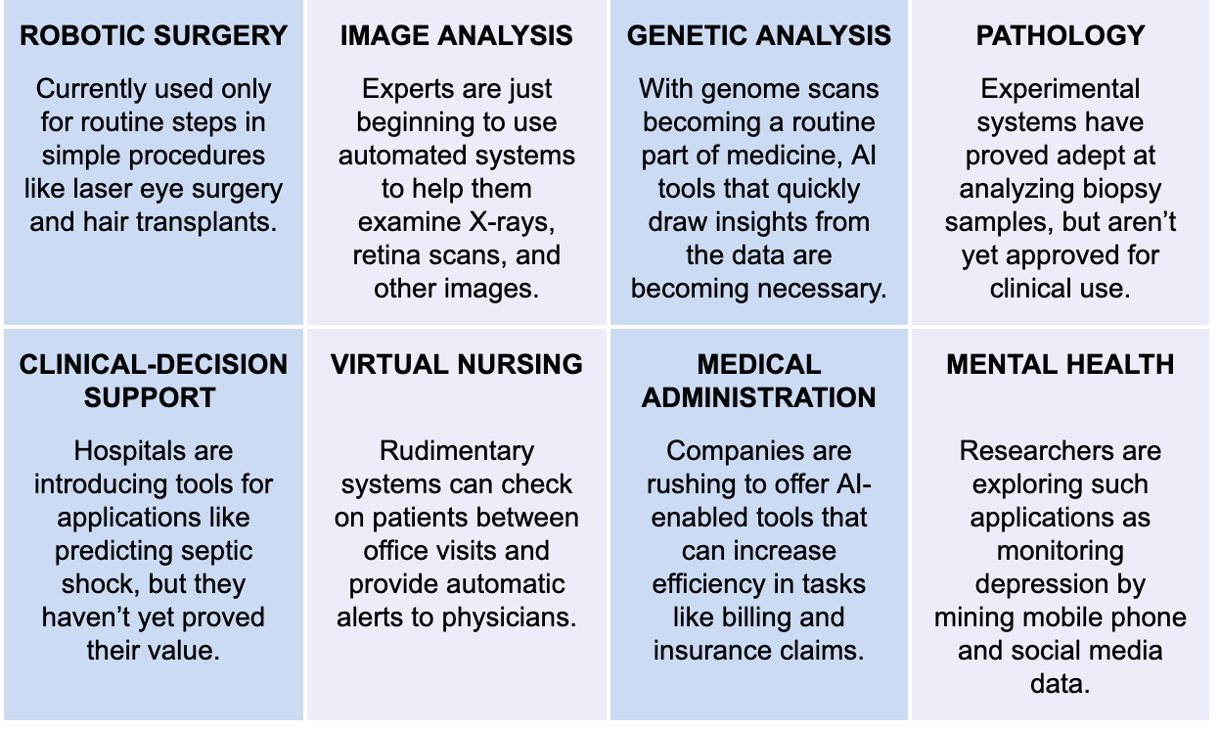

Slide 8
Memorial Sloan Kettering Cancer Center/University of Texas
In many attempted applications, Watson’s NLP struggled to make s
Watson learned fairly quickly how to scan articles about clinical studies and determine the basic outcomes.
But it proved impossible to teach Watson to read the articles the way a doctor would.ense of medical text—as have many other AI systems.

Slide 9
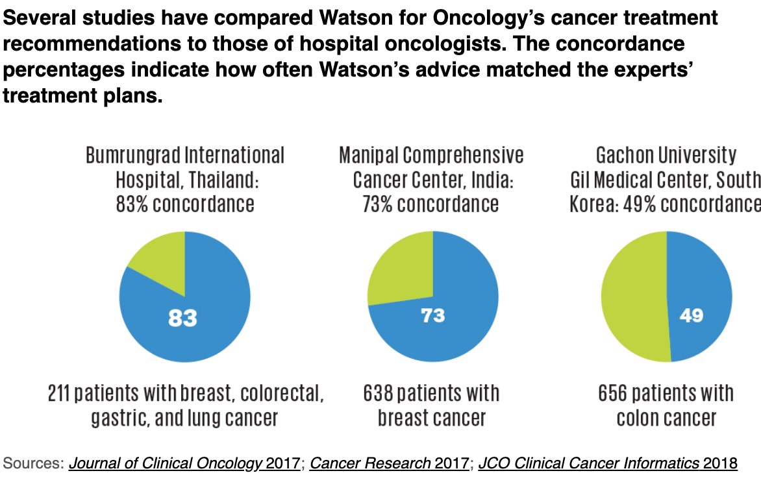
Do you Agree?

Slide 10
Kohn
“The gold standard is not really gold,” Kohn says. AI systems could consider many more factors than will ever be represented in a clinical trial, and could sort patients into many more categories to provide “truly personalized care,”

Slide 11
More success outside of the US
In India, physicians at the Manipal Comprehensive Cancer Center evaluated Watson on 638 breast cancer cases and found a 73 percent concordance rate in treatment recommendations; its score was brought down by poor performance on metastatic breast cancer.
Watson fared worse at Gachon University Gil Medical Center, in South Korea, where its top recommendations for 656 colon cancer patients matched those of the experts only 49 percent of the time.

Slide 12
Genetic Success
Some success stories are emerging from Watson Health—in certain narrow and controlled applications,
the Watson for Genomics product, which was developed in partnership with the University of North Carolina, Yale University, and other institutions.
Watson takes in the file that lists a patient’s genetic mutations, and in just a few minutes it can generate a report that describes all the relevant drugs and clinical trials.
The tool doesn’t employ NLP to mine medical records, instead using it only to search textbooks, journal articles, drug approvals, and clinical trial announcements, where it looks for very specific statements.

Slide 13
Kelly Statements
Michael Kelley, the VA’s national program director for oncology.
“I tend to think of it as a robot who is a master medical librarian.”

